Slide 1
I.R.IRAN AIDC/OLDI Status
Arash Khodaei
a-khodaei@cao.ir

Slide 2
IRAN Air Navigation
Area :1,648,195 km²
~1000 average daily over flights
after Ukraine and Iraq Crisis
12 neighboring FIRs
7 ACC Sectors
2 more flexible sectors.

Slide 3
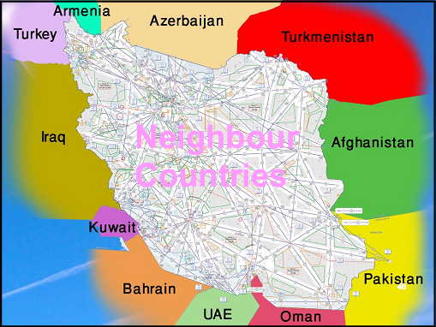
Neighboring FIRs

Slide 4
Airports, Routes and procedures
About 70 Airports
105 ATS Routes
45 ILS CAT 1 Instrument App Procedures.
1 ILS CAT 2 Instrument App Procedures.
120 VOR/DME Instrument App Procedures.
84 VOR Instrument App Procedures.
51 NDB/DME Instrument App Procedures.
96 NDB Instrument App Procedures.
615 STARs
704 SIDs
25 RNAV ATS routes above FL 285

Slide 5
Communications
Fixed Ground- Ground
AFTN
ATSC between ATC units,
Voice
Some OLDI features which are not activated
Mobile Air- Ground
25 RCAGs

Slide 6
Navigation Systems
45 D/VORs
18 ILS/DMEs
62 NDB/DMEs

Slide 7
Surveillance
10 SSR s
6 PSR/SSRs
6 Radar Automation systems
ACC automation with backup
EuroCAT 2000
14 AMDs

Slide 8
OLDI History
OLDI version 2.2 in 2000
Capable of handling:
Advance Boundary Information message (ABI)
Logical Acknowledgment Message (LAM)
ACTivate message (ACT)
No Neighboring FIR was capable for OLDI establishment.
Limited practical use between main and backup ACCs.
Difficulties in recovery due to non-use for long time.

Slide 9
Difficulties
Money we have
Training we can
Intent we will
Equipment upgrade Sanctions

Slide 10
AIDC/OLDI, a Need
Doubled overflies in a blink
Efficiency
Safety

Slide 11
OLDI, the plan
Long term:
To update the system for supporting OLDI v.4.2
OLDI communications with Pakistan, Turkey, UAE, Bahrain
Short term
Handling the existing capabilities with UAE, Turkey
Using stand alone system with UAE for training.

Slide 12
Thank you

